Slide 1
Sales Analysis Report
SUPERMARKET STORE JAN 2019 – MARCH 2019
By : Akande S. Damilola
15th July 2024

Slide 2
Outlines
Project Statement
Project Objectives
Visualizations
Insights
Recommendations
Q/A

Slide 3

Problem Statement
How do customer demographics influence purchasing preferences?
What Branch has the highest sales performance and factor that contribute to its success?

Slide 4
Project Objectives
Determine purchasing behavior and identify trends
Analyze payment preferences methods
Boost sales and revenue
Analyze payment preferences methods

Slide 5
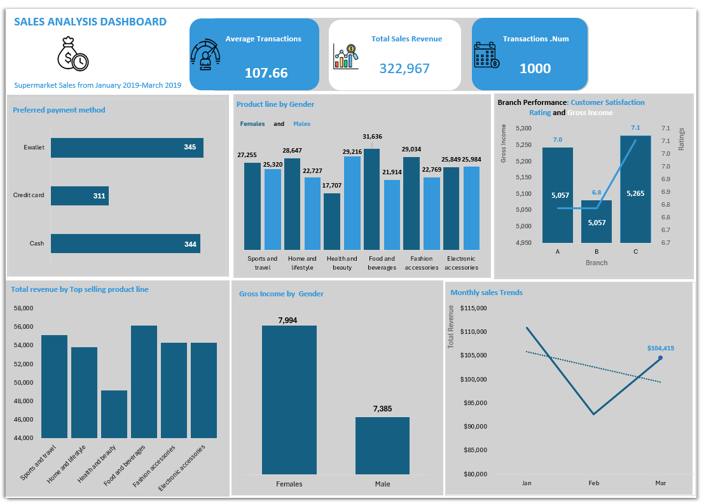
Dashboard Visualization

Slide 6

Insights :KPIs
107.66
Average Transaction Value
$322,967
Total Sales Revenue
1000
Number of Transactions
F
From the data , it was discovered that the total number of transaction made by customers is 1000 ,while the average transaction value is 107.66.Also the total sales revenue is $322,967

Slide 7
Insights and Visualization: Customer Demographics and Preferences
Key findings
• Female customers tend to purchase more in the Food and beverages product line , while the Male customers show preference for Health and beauty product line.
• Female customers have a higher gross income at 7,994 compared to the Male customers gross income at 7,385

Slide 8
Insights and Visualization: Branch Performance
Key findings
• Branch C has the highest average customer satisfaction rating at 7.1 and gross Income at 5,265 compared to the other branches.
• The customer service quality of Branch C rating is higher that other branches leading to increase in customer and high sales.

Slide 9
Insights and Visualization: Purchasing Trends
Key findings
• There is Increase in Sales during January at $110,992 making it the peak sales in 2019 so far.
• A dip in February at $92,721 , and a rise again in March at $104,415

Slide 10
Insights and Visualization: Sales and Revenue
Key findings
• Food and beverages and Sports and travel are the top revenue generating product lines

Slide 11
Insights and Visualization: Payment Preferences
Key findings
• E Wallet is the most frequently use payment method ,followed by Cash and Credit card

Slide 12
Insights
• Branch Performance : Due to success of Branch factors that contribute to its success include the higher customer footfall and customer service ratings.
• Product Line by Gender : There are distinct product preferences based on gender.
• Gross Income by Gender : Female customers tends to spend more and high during there shopping.
• Monthly Sales Trends : Sales vary over the course of three-month period , with notable increases observed in January and March
• Payment Methods : Customers prefer using E- Wallets for Transactions.
• Top selling Product Line : Food and Beverages , Sport and Travel these categories generate the most significant portion of the total sales revenue ( primary contributors ) .

Slide 13
Recommendations
• Optimize Payment Processes : Improve the convenience and efficiency of E – Wallet transactions ,as it is the most frequently used payment method.
• Leverage sales Trends : Plan and execute special promotions and marketing campaigns during January and March to capitalize on the increase of sales during these months.
• Branch Performance Optimization : Replicate the successful strategies of Branch C in other branches . This include enhancing customer service quality and also making other branches attractive to customers.

Slide 14
THANK YOU!
Do you have any questions?

